Slide 1
Node.js New-age Features and Frameworks
Amir Yahalom, SAP.

Slide 2
Async Hooks
As Node is an event-driven and single-threaded platform, we have no thread context we can relay on, since we only have one thread but multiple contexts in the form of callbacks/events/tasks
We can pass a context object to all functions
It won’t scale well
Hard maintenance
Async Hooks module provides an API for tracking the lifetime and flow of asynchronous events

Slide 3
Worker Threads
Let us create multiple threads to delegate work from the main thread
Node.js is running concurrently, worker threads works in parallel
Workers are useful for performing CPU intensive operations
They will not help much with I/O intensive work

Slide 4
Worker Threads
worker_threads module exports the following:
Worker (function/class) - A class to create a new worker thread
Accepts a path to a script, and an object with “workerData” property
Called to spawn a new thread
The instance can be used to emit/listen to events, kill and restart it.
workerData (object): Contains the data that is passed to Worker constructor
isMainThread (boolean): A flag that tells us if we are on the main thread
parentPort (object): Enable to emit messages to the parent thread

Slide 5
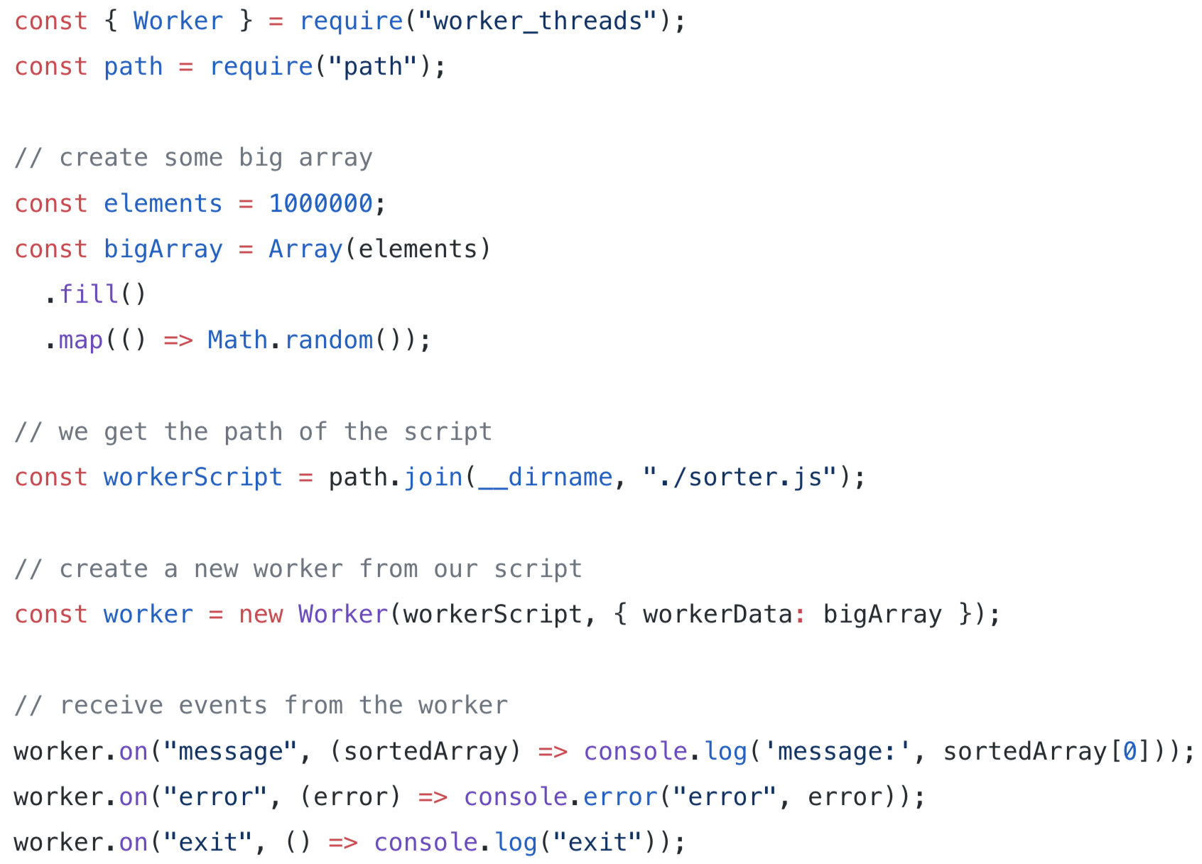
Worker Threads
Main thread →

Slide 6
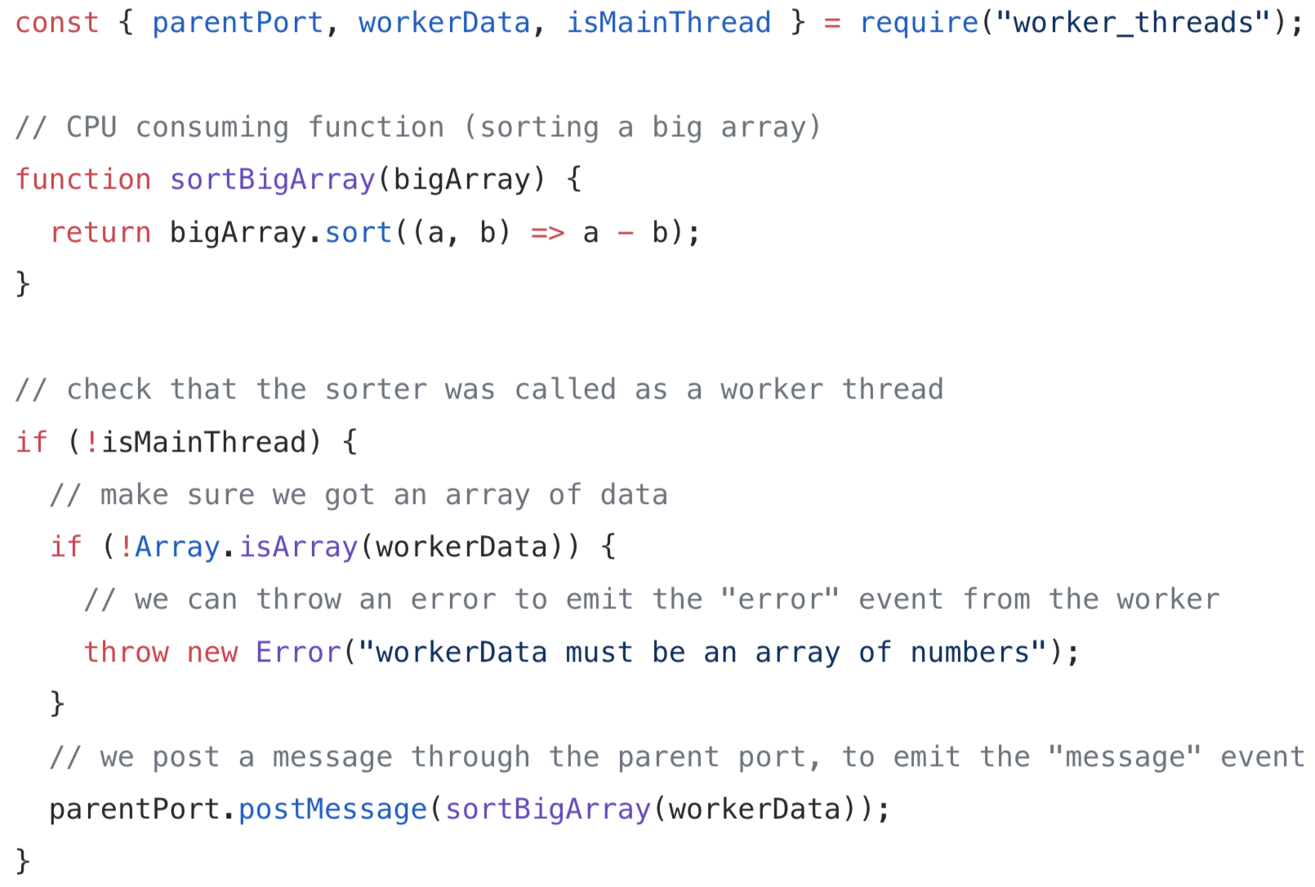
Worker Threads
Worker thread →

Slide 7
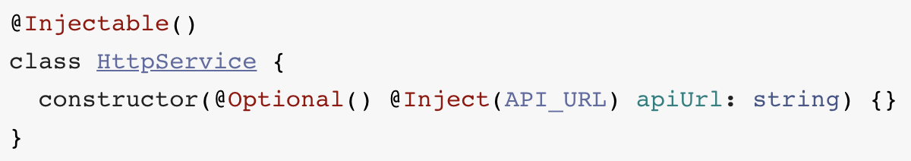
Decorators (AKA @annotations)
A decorator is a way of wrapping one piece of code - i.e. “decorating” it
Similar to functional composition and higher-order functions
Allow a cleaner syntax for applying wrappers around your code
There are decorators for classes, properties and arguments
Example - @decorators/di:

Slide 8
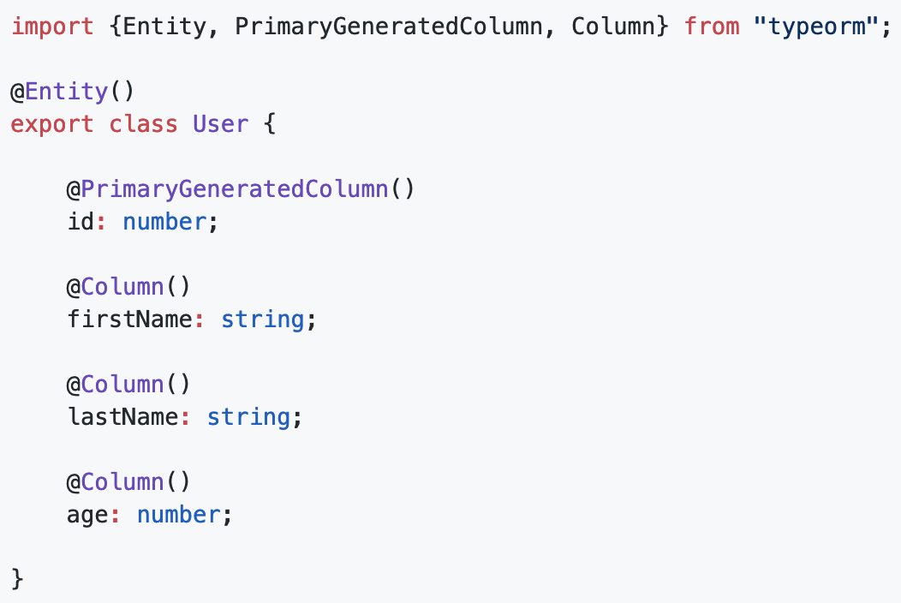
Cool Frameworks
TypeORM is an ORM (e.g. Hibernate, Entity Framework…) that can run on multiple Node.js / JS platforms (browser, cordova, Ionic, react-native, electron)

Slide 9
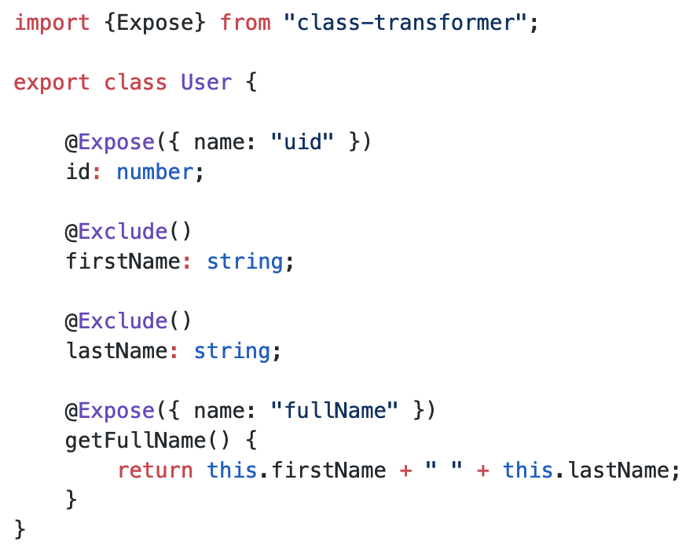
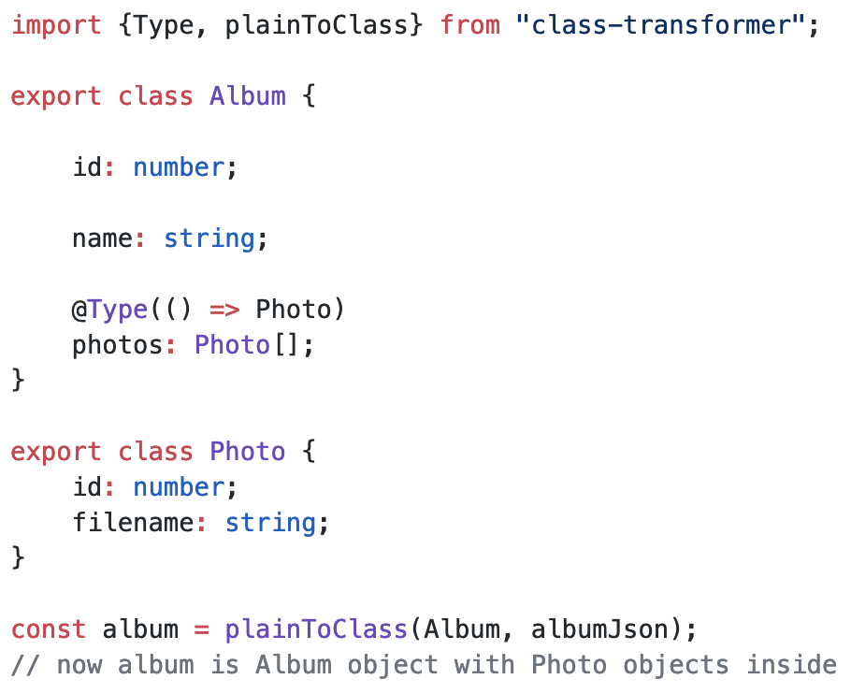
Cool Frameworks
class-transformer is a decorator-based transformation, serialization and deserialization of plain javascript objects to class constructors

Slide 10
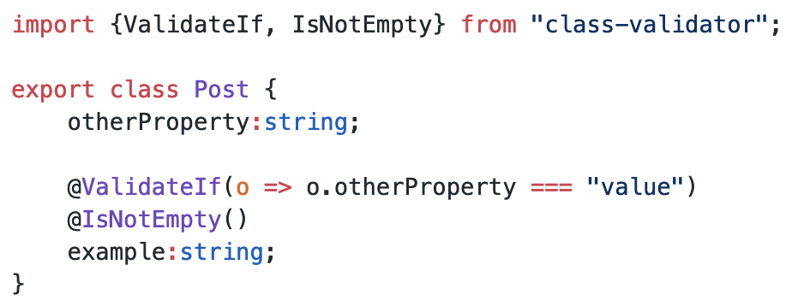
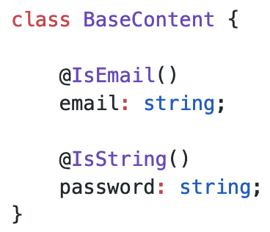
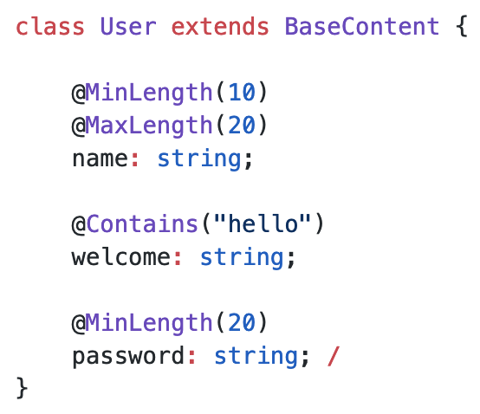
Cool Frameworks
class-validator is similar, but it does validation instead of transformation
Includes a rich set of built-in decorators
Enables to define validation schema w/o decorators
Handles arrays, nested objects, conditional validation
Enables OOP (i.e. to inherit)

Slide 11

Cool Frameworks
class-transformer vs class-validator:

Slide 12

Cool Frameworks
Moleculer is a progressive microservices framework
Super fast comparing to other frameworks like Seneca
has built-in load balancer, circuit breaker, retries, timeout and bulkhead features

Slide 13

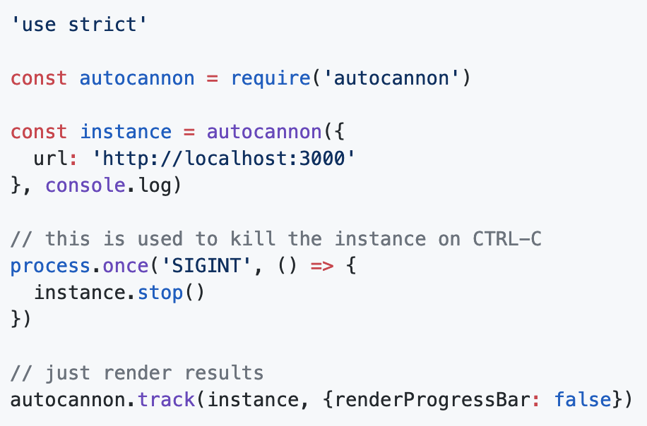
Cool Frameworks
AutoCannon – a fast HTTP/1.1 benchmarking tool written in Node.js
Can be used via CLI
Or programmatically

Slide 14
Links
Top 10 Mistakes Node.js Developers Make
Node worker threads
Tasks, microtasks, queues and schedules
Nest.js Brings TypeScript to Node.js and Express
JavaScript Decorators: What They Are and When to Use Them
Async Hooks — A whole new world of opportunities

Slide 15
Thank You

